Slide 1
Math Object
Introduction to Math Object | Math Methods | Producing Random Numbers
Notes:
Welcome to our lecture on math objects in JavaScript. In this lecture we will go through introduction to math objects, math methods, and how to produce random numbers. Let’s start our lecture.

Slide 2
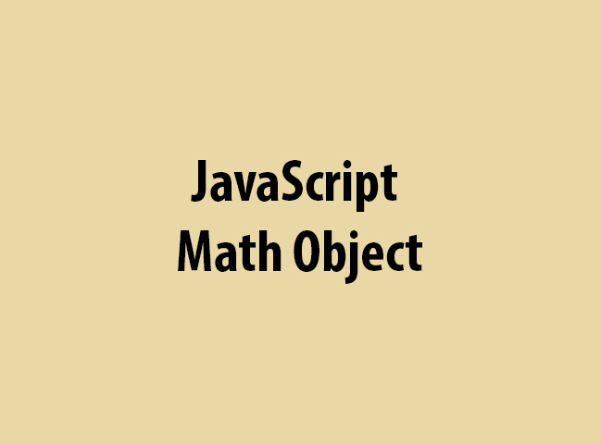
Introduction Math Object
Math object offers mathematical constants and functions.
Contains properties like Math.PI and Math.E.
Provides methods for calculations like Math.sqrt() and Math.pow().
Notes:
Today, we are introducing the JavaScript Math object. This built-in object provides mathematical constants and functions for calculations. It includes properties like Math PI for the value of pi and Math E for Euler’s number. It also offers methods like Math sqrt to find square roots and Math pow for exponentiation. These features make mathematical operations easy and efficient in JavaScript.

Slide 3
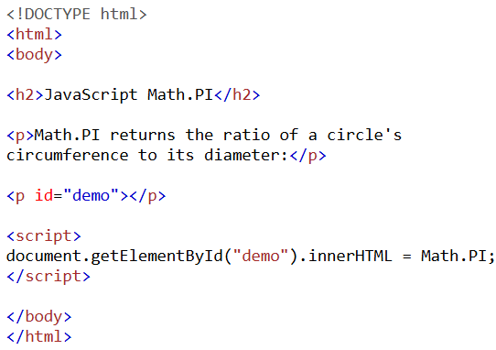
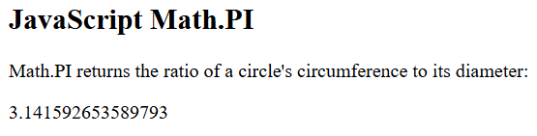
Example
Notes:
Let’s look at an example of the JavaScript Math PI property. This property returns the ratio of a circle’s circumference to its diameter. In this example, we use HTML and JavaScript to display the value of Math PI. The script selects an element with an id of demo and sets its content to Math PI. This demonstrates how we can easily access mathematical constants in JavaScript.

Slide 4
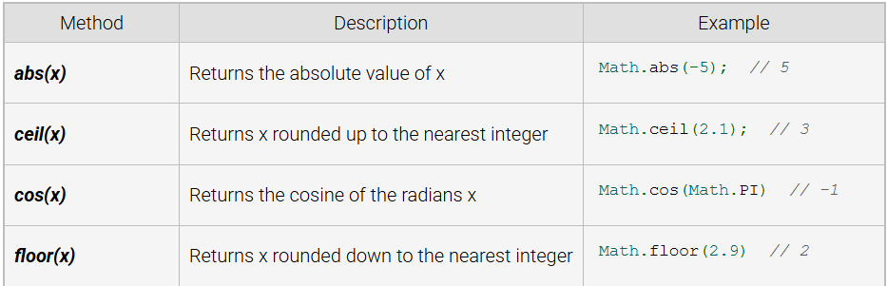
Math Methods
Notes:
Now, let’s explore some important JavaScript Math methods. The abs method returns the absolute value of a number. The ceil method rounds a number up to the nearest integer, while the floor method rounds it down. The cos method calculates the cosine of a given angle in radians. These methods are useful for performing various mathematical operations in JavaScript.

Slide 5
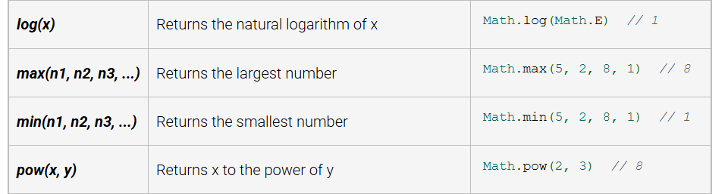
Math Methods
Notes:
Let’s explore more JavaScript Math methods. The log method returns the natural logarithm of a number. The max method finds the largest value among multiple numbers, while the min method finds the smallest. The pow method calculates the power of a number by raising x to the exponent y. These methods help perform advanced mathematical calculations efficiently in JavaScript.

Slide 6
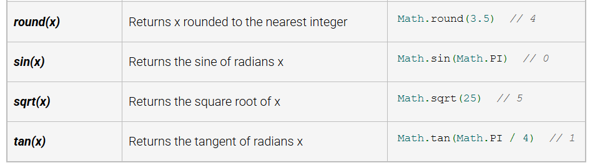
Math Methods
Notes:
Now, let’s look at more JavaScript Math methods. The round method rounds a number to the nearest integer. The sin method returns the sine of an angle in radians. The sqrt method calculates the square root of a number, while the tan method finds the tangent of an angle. These methods are useful for performing various mathematical calculations in JavaScript.

Slide 7
Producing Random Numbers
Random numbers are essential for simulations and games to mimic randomness.
Math.random() generates a pseudo-random number between 0 (inclusive) and 1 (exclusive).
Pseudo-random numbers are algorithm-based and approximate true randomness.
Notes:
Random numbers play a key role in simulations and games by creating unpredictability. In JavaScript, the Math random method generates a pseudo-random number between zero and one. These numbers are not truly random but are based on algorithms that approximate randomness. This makes them useful for applications like gaming, cryptography, and statistical simulations.

Slide 8
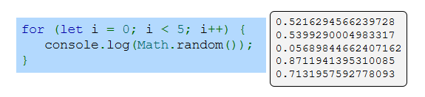
Example
Notes:
Now, let’s see an example of generating random numbers in JavaScript. In this loop, we use Math random to generate and print five random numbers. Each time the function runs, it produces a new pseudo-random number between zero and one. This method is useful for simulations, games, and applications that require randomness. Thanks for watching the lecture.

